Slide 1
Learning to Crochet
Caroline Amadeo
caroline.amadeo@yale.edu

Slide 2
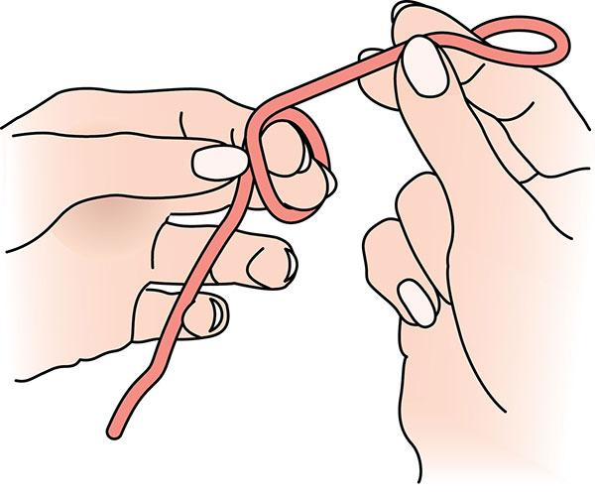
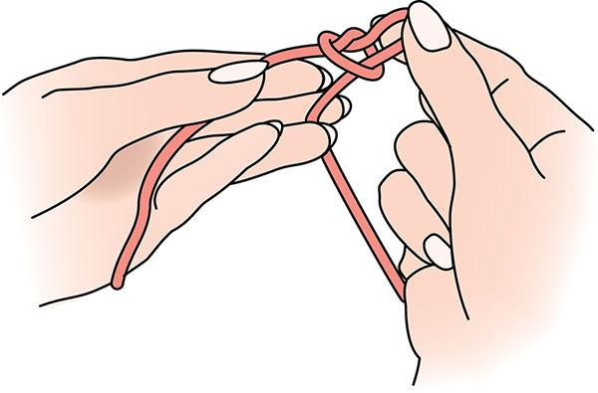
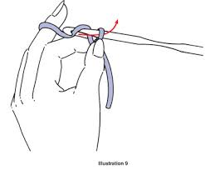
Slip Knot
Make a circle with your yarn.
Pull a loop through the circle you made in step 1.
Insert the hook onto loop
Pull the loop tight by sliding the knot close to your hook.
Or you can make it using your hook which is pictured here

Slide 3
The Chain Stitch
The most BASIC and FUNDAMENTAL stitch in crocheting. Used ALL the time, and everytime you start a project.
Wrap your yarn around the crochet hook, above the loop that is already there. (When you wrap your yarn like this it is called a “yarn over” or “yo” for short.)
Slide both loops toward the top of your hook. The top one should be resting inside the hook.
Carefully angle your hook so that it catches the top loop, BUT NOT THE BOTTOM LOOP!
Slide the bottom loop up and over the top. Now you should have just one loop on your hook.

Slide 4
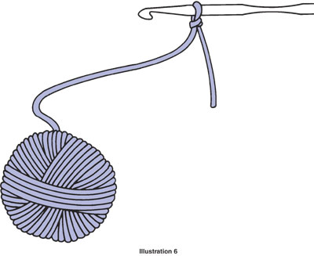
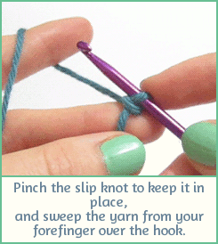
Step 1: Yarn over
Wrap your yarn around the crochet hook so that it lies above the loop that is already there.
SO apparently, I don’t even do this part right.
The “correct” way is to wrap the yarn around the back and then going to the front, but I wrap it from front to back. Do it the correct way, it will make your work lie flat and look prettier.

Slide 5
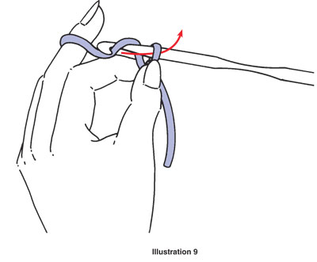
Steps 2 and 3: Slide the loops up and angle your hook
Slide both loops toward the top of your hook. The top one should be resting inside the hook.
Carefully angle your hook so that it catches the top loop, BUT NOT THE BOTTOM LOOP!
It turns out if you yarnover correctly it is actually easier to catch the first loop.

Slide 6
Step 4: Slide the bottom loop off.
Slide the bottom loop up and over the top. Now you should have just one loop on your hook.
This part can be tricky, but with practice you will get the hang of it.
Now you repeat the process to make a chain.

Slide 7
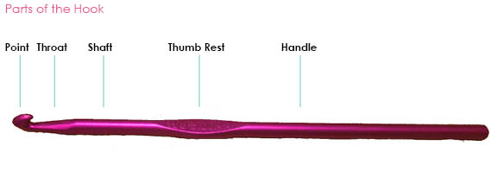
TIPS
Pinch the bottom of the slip knot and pull it away from the hook to make space for the head of the hook to go through.
Twist the hook so that the “nose/tip” is facing downwards to help catch the top loop. From there, if you pull directly horizontally, the bottom loop should just slide off the back nice and easy.
Making your chain looser will make it easier to work with later on.

Slide 8
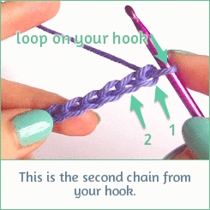
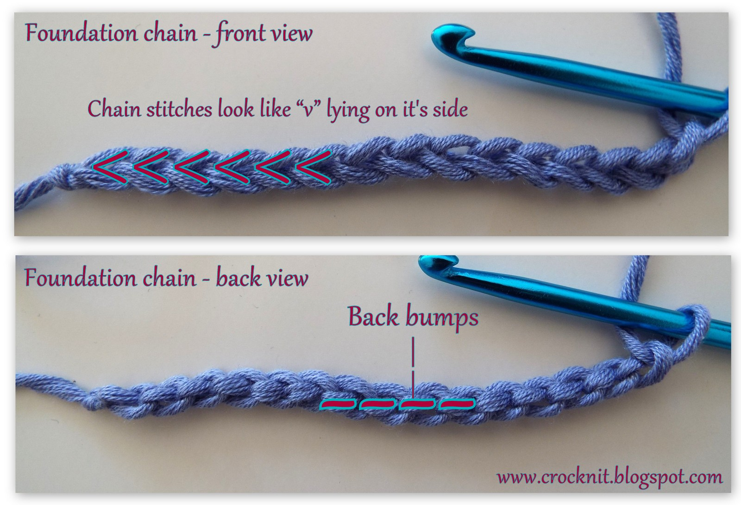
**Important things to know about your chain

Slide 9
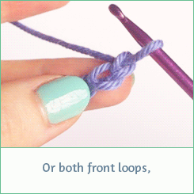
Crocheting into your chain
There are a number of different ways to insert your hook into the chain but we are going to use this method →
Insert the hook through both front loops, aka both sides of the “V” we talked about earlier.

Slide 10
Single Crochet (sc)
Single crochet (sc), double crochet (dc), and even triple crochet (tc) are used to build up from a chain. A single crochet is as tall as one chain stitch.
Insert your hook into the stitch you are anchoring your sc onto. We just did this on the last slide :)
“Grab” the yarn running from your work and pull it back through. You can also think of this step as a yarn over.
Wrap your yarn around your hook from back to front (yarn over)
Pull the top loop through the bottom two loops.

Slide 11
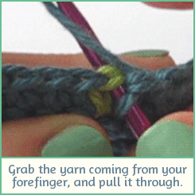
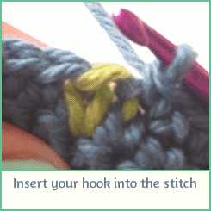
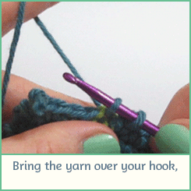
Steps 2 and 3: Grab the yarn, pull it through, and yo
“Grab” the yarn running from your work and pull it back through. You can also think of this step as a yarn over.
Wrap your yarn around your hook from back to front (yarn over)
STEP TWO IS KEY!

Slide 12
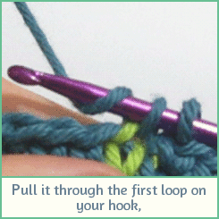
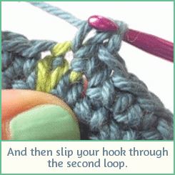
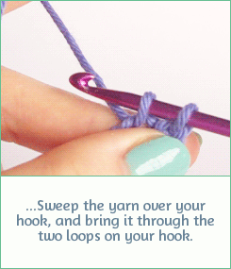
Step 4: Pull through the two loops.
Pull the top loop through the bottom two loops.
You can also break this up and pull it through each loop one at a time, as pictured below. It doesn’t, matter, but as you get faster, going through both loops together will increase your efficiency.

Slide 13
Double Crochet (dc)
In our pattern, we will exclusively be using double crochet. A double crochet is as tall as 2-3 chain stitches, so you will need to use 2-3 chains as the turning stitches.
Yarn over before you insert your hook into the stitch.
Insert your hook into the stitch, grab the yarn and bring it back through, (yo).
Sweep your yarn around the hook so you have a total of four loops on your hook.
Pull the top loop through the first two loops only.
Yarn over again and pull it through the last two loops.

Slide 14
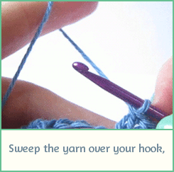
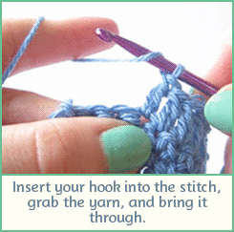
Steps 1 and 2: yo, insert into stitch, grab and pull thru
Yarn over before you insert your hook into the stitch.
Insert your hook into the stitch, grab the yarn and bring it back through, (yo).
DON’T FORGET TO YARN OVER BEFORE YOU INSERT YOUR HOOK.

Slide 15
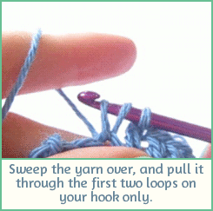
Steps 3 and 4: Yarn over and pull thru 1st 2 loops
Sweep your yarn around the hook so you have a total of four loops on your hook.
Pull the top loop through the first two loops only.

Slide 16
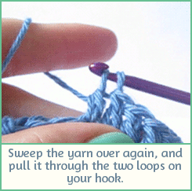
Step 5: yo again and pull through the last 2 loops
What I just said in the title lol.

Slide 17
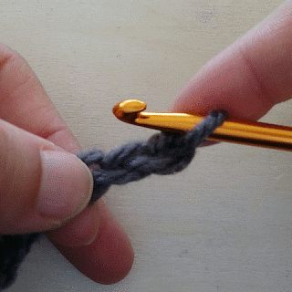
Slip Stitch
We are going to be using the slip stitch to attach the bottom of our scarf to the top to make it into a loop. I think that the slip stitch is super similar to the single crochet, so just know that they are different!
Insert needle into stitch, grab the yarn and pull it through.
From here, keep pulling that yarn through the bottom stitch.
In a single crochet, you would yarn over after step 1, and then pull that through both the bottom stitches.
The slip stitch is useful for attaching two things, especially if you are working in a circle or a square shape.

Slide 18
Weaving in your ends
I actually am the worst at this so here is a video that explains how to do it with both a crochet hook and a tapestry needle.
https://youtu.be/Ei-zZyTFzyQ?t=140
Tumblr page where I got these gifs
http://crochet-gifs.tumblr.com/

